Slide 1
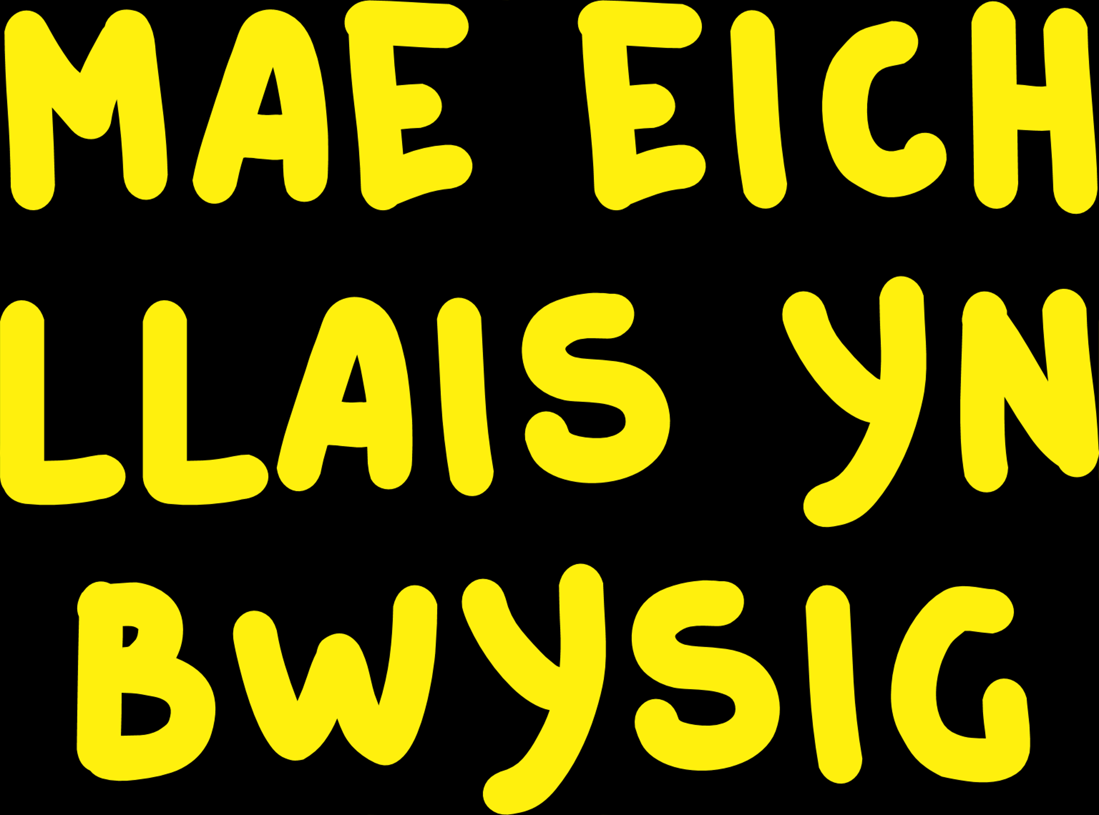

Slide 2
FIDEO THEMA

Slide 3
Erthygl 12
Mae gennych yr hawl i farn ac i rywun wrando arni a'i chymryd o ddifrif.

Slide 5
“Finding your voice and purpose in life is one thing, but, very often, when it is time to use that voice and make a change, you will need a bit of teamwork to make things happen.”
Marcus Rashford
(o You Can Do It; How to find your voice and make a difference, 2022)

Slide 6
Beth allwn ni ei wneud fel tîm i wneud i rywbeth ddigwydd yn ein hysgol? Gadewch i ni bleidleisio...
OPSIWN 1
OPSIWN 2

