Slide 1

Children’s Mental Health Week
3-9 February 2020
ASSEMBLY SLIDES FOR SECONDARY-AGE CHILDREN

Slide 2
Bravery comes in all shapes and sizes.
Everyday bravery is something we all need throughout our lives. It’s good for our mental health to:
try something new
push outside our comfort zone
share worries and ask for (and accept) help
Slide 2

Slide 3
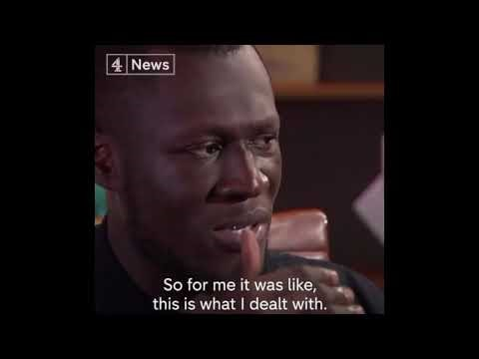
Slide 3

Slide 4
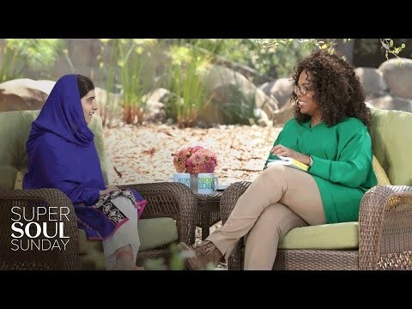
Slide 3

Slide 5
Slide 4

Slide 6
Felt proud
Felt good about myself
More confident
Empowered
Stopped keeping worries to myself
More positive
Felt stronger
Enjoyed trying new things
Slide 5

Slide 7
Bravery toolbox
Slide 6

Slide 8
Add what you’re doing here
Add what you’re doing here
Add what you’re doing here
Slide 7

Slide 9
If you have worries or are unsure about something you can always talk to:
a member of school staff
an adult you trust
insert name of school counsellor if you have one
a teacher
Find useful organisations at www.place2be.org.uk/contacts
Slide 8

Slide 10
All images in this presentation are copyright free from
pixabay.com and shutterstock.com

