Slide 1

Children’s Mental Health Week
3-9 February 2020
ASSEMBLY SLIDES FOR PRIMARY-AGE CHILDREN

Slide 2
Slide 2

Slide 3
Slide 3

Slide 4
Slide 4

Slide 5
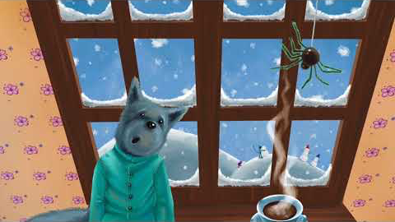
Slide 5

Slide 6

Slide 6
Add thumbnail of the Show and Tell pack/poster etc

Slide 7
Slide 7
If you have worries or are unsure about something you can always talk to:
a member of school staff
an adult you trust
insert name of school counsellor if you have one
a teacher

Slide 8
Slide 8
All images in this presentation are copyright free from pixabay.com
The book The Wolf’s Colourful Coat is written and read by Avril McDonald
https://www.youtube.com/watch?v=Z2593x-H3xQ

