Slide 1
CMHW logo, my voice matters

Slide 2
Notes:
Link to video if not working: https://www.youtube.com/watch?v=G1gvP09JLm0&embeds_referring_euri=https%3A%2F%2Fhubblecontent.osi.office.net%2F&source_ve_path=MzY4NDIsMjM4NTE&feature=emb_title&ab_channel=Place2Be

Slide 3
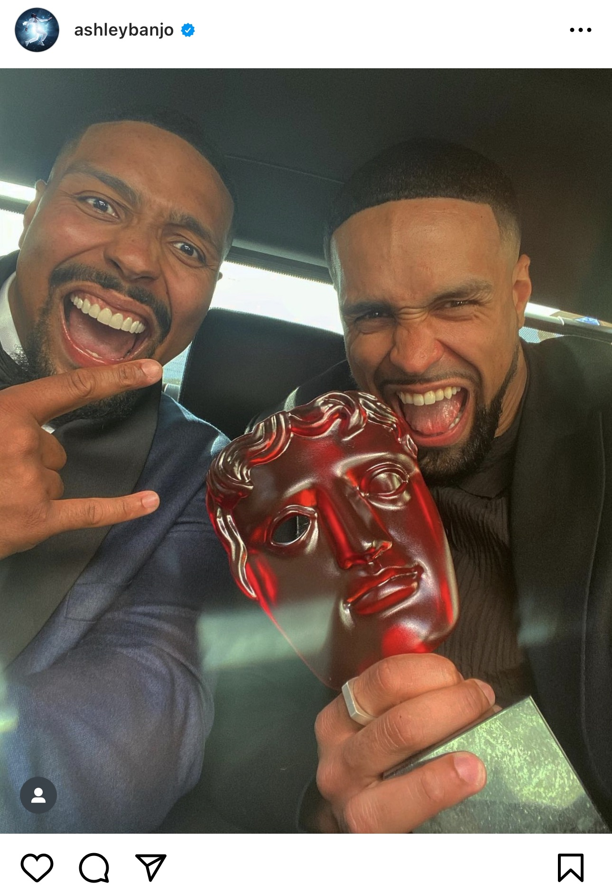

Slide 4
Notes:
Link to video: https://www.youtube.com/watch?v=kzFNKFitHjw&ab_channel=Britain%27sGotTalent

Slide 6
Notes:
Link to video:https://www.youtube.com/watch?v=_m1RKEPY79U&embeds_referring_euri=https%3A%2F%2Fhubblecontent.osi.office.net%2F&source_ve_path=MzY4NDIsMjM4NTE&feature=emb_title&ab_channel=TheGrahamNortonShow

Slide 7
How can you use
YOUR voice?

